Slide 1
Plant environment control
Kyle Joaquim

Slide 2
hardware
ESP8266
DHT11 Temperature & Humidity Sensor
Power Strip with Relay
Submersible Pump
Soil VWC Sensor
Raspberry Pi

Slide 3
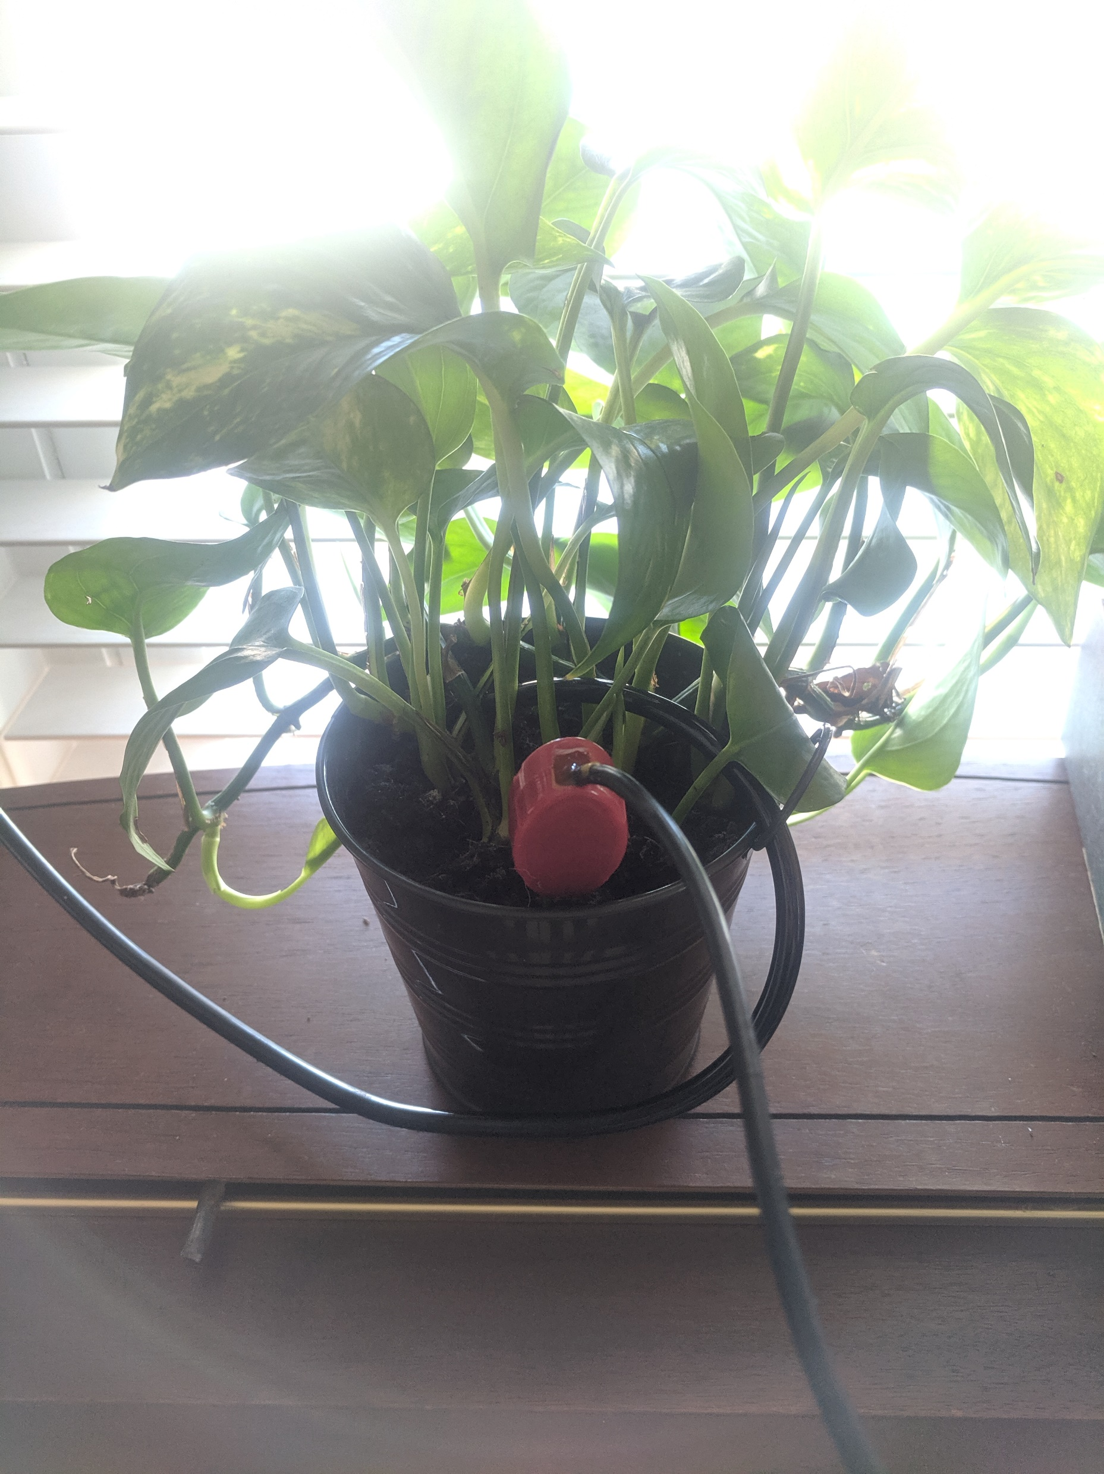
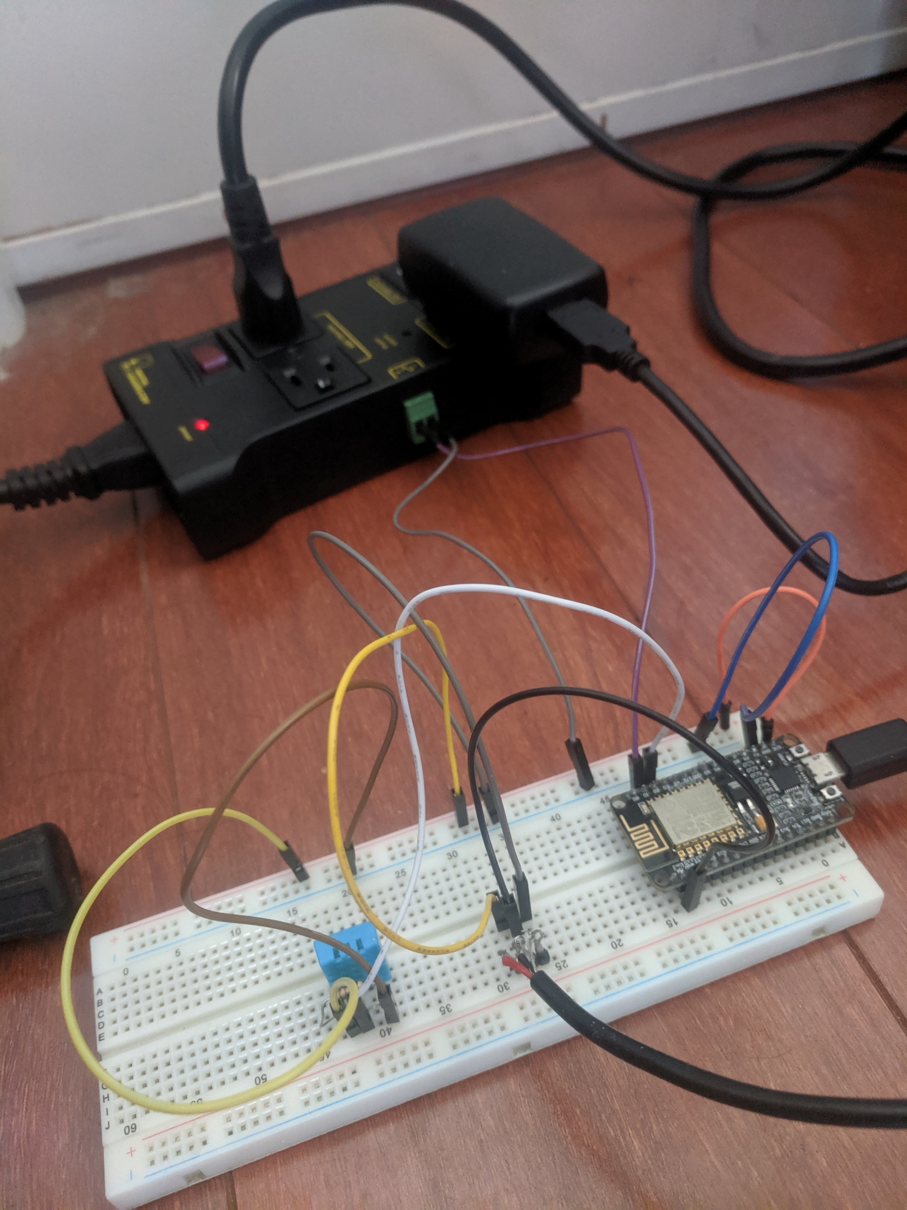

Slide 4
Automatic watering
Volumetric Water Content is calculated onboard the ESP
When VWC falls below a certain value, the ESP sends a signal to the relay in the power strip to turn on the pump for 3 seconds, delivering ~1 oz. of water.
This holds the VWC steady so “field capacity” can be maintained
The automatic watering can be toggled on and off with a simple flag.

Slide 5
DATA HANDLING
Mosquitto (MQQT) used to send readings of temperature, humidity, and VWC at set intervals.
The RPI receives these readings and stores them in an InfluxDB database.
It also checks to ensure that each of the values fall within a safe range. The RPI has potential to control smart outlets in the room, using a space heater & humidifier to maintain values within range.
If VWC is too high or low, the RPI sends a message to the ESP to toggle off the automatic watering system. Then, it sends an appropriate SMS alert using Twilio API.

Slide 6
TWILIO API & FLASK
A Flask server runs on the Raspberry Pi and is linked to a Twilio phone number. When SMS messages are sent to this number, they are redirected to the Flask API via HTTP requests – this is called a webhook.
Through the API, devices in the room (pump, heater, humidifier) can be controlled. The InfluxDB database can also be queried, returning data about the plant environment over the past week to the phone number the request was received from.
Average temperature, average humidity, heater & humidifier runtime, water consumption, average span between watering

Slide 7
FUTURE CONSIDERATIONS
Didn’t get to implement certain events, such as soil sensor error detection and humidifier empty alert.
Concerns about scalability.
Light sensing & control.

